Slide 1
OAuth 2

Slide 2
Introduction
How to allow John to authorize a 3rd party app to access his images at Facebook?
Some issues to consider:
  The app can only access John's images and not other data or perform other actions.
  The app cannot access other users' images
  The authorization is only given to a particular app
  John should be allowed to revoke the authorization
John
Image Manipulation App
Facebook
API to retrieve user images

Slide 3
Overview of Oauth 2
It is an authorization framework that enables applications to obtain limited access to user accounts on an HTTP service.

Slide 4
OAuth Roles
Resource Owner
  User who own the data
Client
  Web application or Mobile App that wants to access/manipulate user's data.
Authorization Server
  The server that grants access tokens to the client. The tokens are to be used by the client to request access to user's data at the resource server.
  e.g., Google, Facebook
Resource Server
  The server where user's data are stored.
  e.g., Dropbox, Google Drive

Slide 5
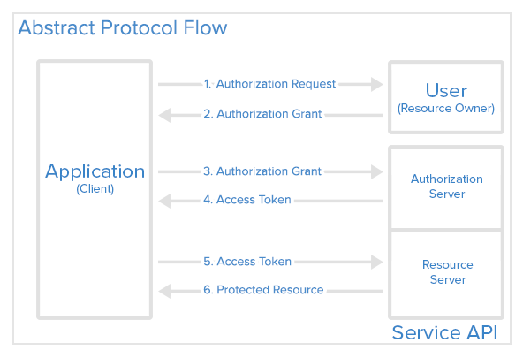
(General Idea)
Source: https://www.digitalocean.com/community/tutorials/an-introduction-to-oauth-2

Slide 6
Explanation
The application requests authorization to access service resources from the user
If the user authorized the request, the application receives an authorization grant
The application requests an access token from the authorization server (API) by presenting authentication of its own identity, and the authorization grant
If the application identity is authenticated and the authorization grant is valid, the authorization server (API) issues an access token to the application. Authorization is complete.
The application requests the resource from the resource server (API) and presents the access token for authentication
If the access token is valid, the resource server (API) serves the resource to the application

Slide 7
Application Registration
A client registers with the service and supply the following data
  Application Name
  Application Website
  Redirect URI or Callback URI
The Callback URI is to be used by the service to
  redirect the user after they authorize (or deny) the client
  inform the client whether the authorization is accepted or denied

Slide 8
Client ID and Client Secret
Upon successful registration, the service will issue "client credentials" in the form of
Client ID (or API Key)
  A publicly exposed string
Client Secret
  Serve like a "password" of the client
  Must be kept private

Slide 9
Confidential and Public Clients
OAuth 2 classified clients into two categories:
Confidential Client
  Able to protect the client key and client secret
Public Client
  Cannot protect client secrets
  e.g., Mobile app, single-page app

Slide 10
Authorization Grant (4 types)
OAuth 2 defines four grant types for different cases
Authorization Code: Used with server-side Applications
Implicit: Use by "public" apps that cannot keep client secret private. (e.g., mobile apps, single page web app)
Resource Owner Password Credentials: Used with trusted applications such as those own by the service itself.
Client Credentials: Used with Applications API access

Slide 11
Grant type: Authorization Code
Used by server-side applications where client secret can be kept private.
Redirection-based flow
User interacts with the application and the authorization server via a user-agent (browser)
  The application will receive authorization codes that are routed through the user-agent.
Notes:
The authorization code grant type is the most commonly used because it is optimized for server-side applications, where source code is not publicly exposed, and Client Secret confidentiality can be maintained. This is a redirection-based flow, which means that the application must be capable of interacting with the user-agent (i.e. the user's web browser) and receiving API authorization codes that are routed through the user-agent.

Slide 12
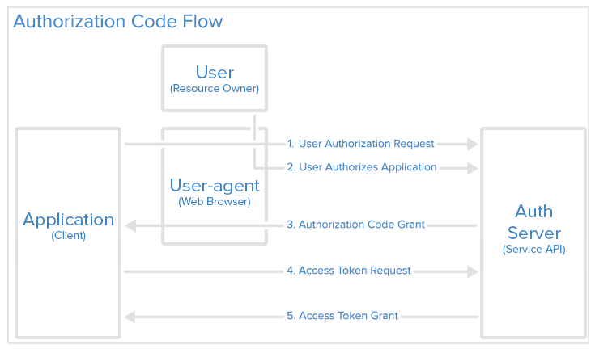
Grant type: Authorization Code

Slide 13
Grant type: Authorization Code
Step 1: Authorization Code Link
The user is given an authorization code link
https://cloud.digitalocean.com/v1/oauth/authorize?response_type=code&client_id=CLIENT_ID&redirect_uri=CALLBACK_URL&scope=read
Notes:
https://cloud.digitalocean.com/v1/oauth/authorize: the API authorization endpoint
client_id=client_id: the application's client ID (how the API identifies the application)
redirect_uri=CALLBACK_URL: where the service redirects the user-agent after an authorization code is granted
response_type=code: specifies that your application is requesting an authorization code grant
scope=read: specifies the level of access that the application is requesting

Slide 14
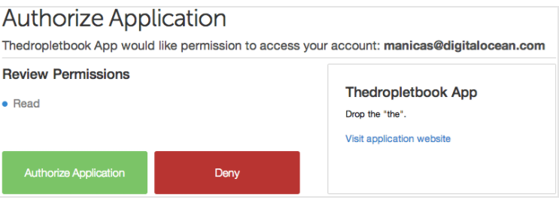
Grant type: Authorization Code
Step 2: User Authorizes Application
After visited the links, the user is asked to grant (or deny) the application the listed permission.

Slide 15
Grant type: Authorization Code
Step 3: Application Receives Authorization Code
If the user authorizes the application, the service redirect the user-agent to the application redirect URI, along with an authorization code.
HTTP/1.1 302 Found
Location: https://dropletbook.com/callback?code=AUTHORIZATION_CODE

Slide 16
Grant type: Authorization Code
Step 4: Application Requests Access Token
The application send authorization code, client id, client secret to the authorization server to request access token.
POST /v1/oauth/token HTTP/1.1
…
client_id=CLIENT_ID&client_secret=CLIENT_SECRET&grant_type=authorization_code&code=AUTHORIZATION_CODE&redirect_uri=CALLBACK_URL

Slide 17
Grant type: Authorization Code
Step 5: Application Receives Access Token
In the authorization is valid, the authorization server will send a response containing the access token (and optionally a refresh token).
HTTP/1.1 200 OK
…
{"access_token":"ACCESS_TOKEN","token_type":"bearer","expires_in":2592000,"refresh_token":"REFRESH_TOKEN","scope":"read","uid":100101,"info":{"name":"Mark E. Mark","email":"mark@thefunkybunch.com"}}

Slide 18
Grant type: Implicit
Used mainly by public client
  e.g., Mobile apps, Single-page web apps.
Notes:
The authorization code grant type is the most commonly used because it is optimized for server-side applications, where source code is not publicly exposed, and Client Secret confidentiality can be maintained. This is a redirection-based flow, which means that the application must be capable of interacting with the user-agent (i.e. the user's web browser) and receiving API authorization codes that are routed through the user-agent.

Slide 19
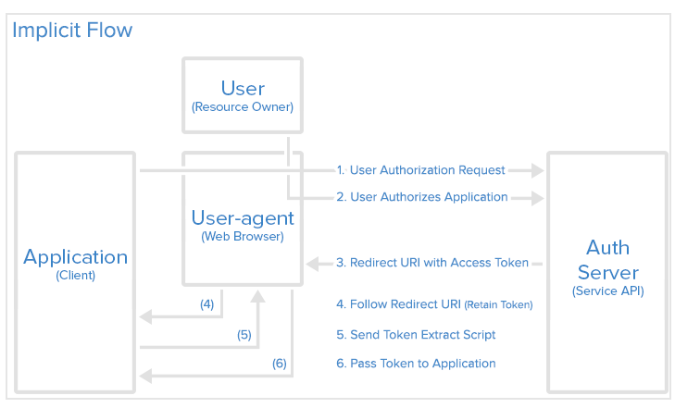
Grant type: Implicit

Slide 20
Grant type: Implicit
Step 1: Implicit Authorization Link
The user is given an authorization link that requests a token (not authorization code)
https://cloud.digitalocean.com/v1/oauth/authorize?response_type=token&client_id=CLIENT_ID&redirect_uri=CALLBACK_URL&scope=read
Notes:
https://cloud.digitalocean.com/v1/oauth/authorize?response_type=token&client_id=CLIENT_ID&redirect_uri=CALLBACK_URL&scope=read

Slide 21
Grant type: Implicit
Step 2: User Authorizes Application
After visited the links, the user is asked to grant (or deny) the application the listed permission.

Slide 22
Grant type: Implicit
Step 3: User-agent Receives Access Token with Redirect URI
If the user authorizes the application, the service redirects the user-agent to the application redirect URI, along with the access token.
HTTP/1.1 302 Found
Location: https://dropletbook.com/callback#token=ACCESS_TOKEN

Slide 23
Grant type: Implicit
Step 4: User-agent Follows the Redirect URI
The user-agent follows the redirect URI but retains the access token.
Step 5: Application Sends Access Token Extraction Script
The application returns a webpage that contains a script that can extract the access token from the full redirect URI that the user-agent has retained.
Step 6: Access Token Passed to Application
The user-agent executes the provided script and passes the extracted access token to the application.

Slide 24
Grant type: Resource Owner Password Credentials
The trusted confidential client uses the user credentials (username and password) directly to the request access token from the service.
A mean to stay backward compatible with OAuth 1

Slide 25
Grant type: Client Credentials
Used by confidential client to access its own service account (i.e., the resources it own)

